Slide 1

Body Language Decoder

Slide 2
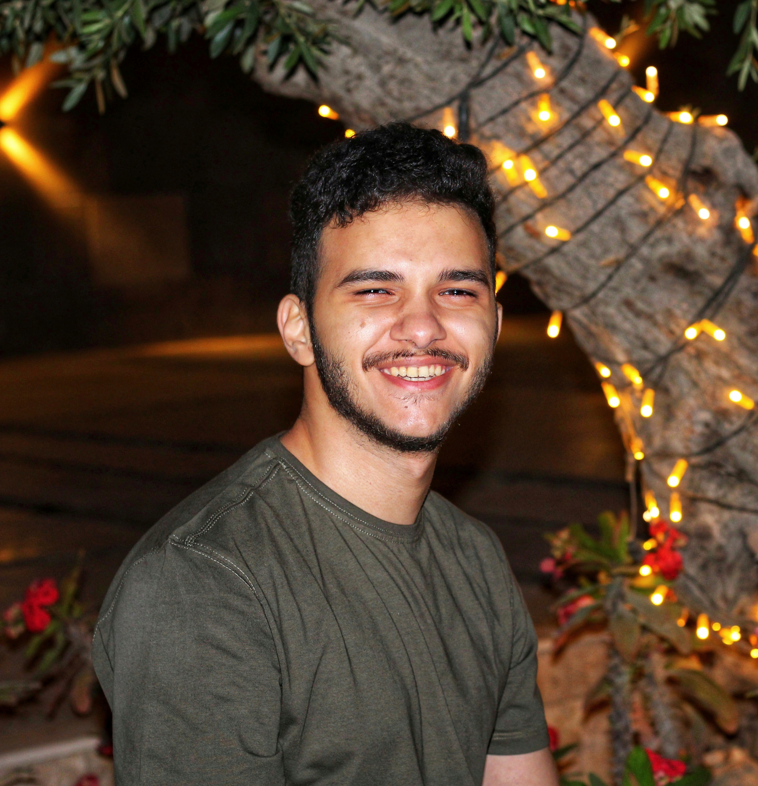
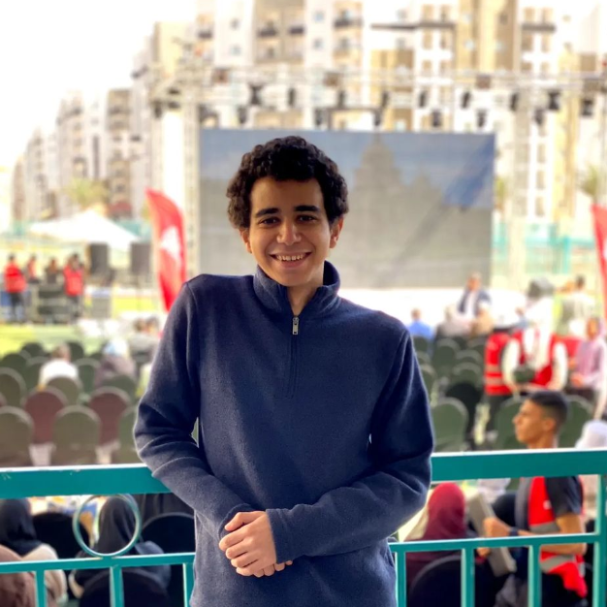

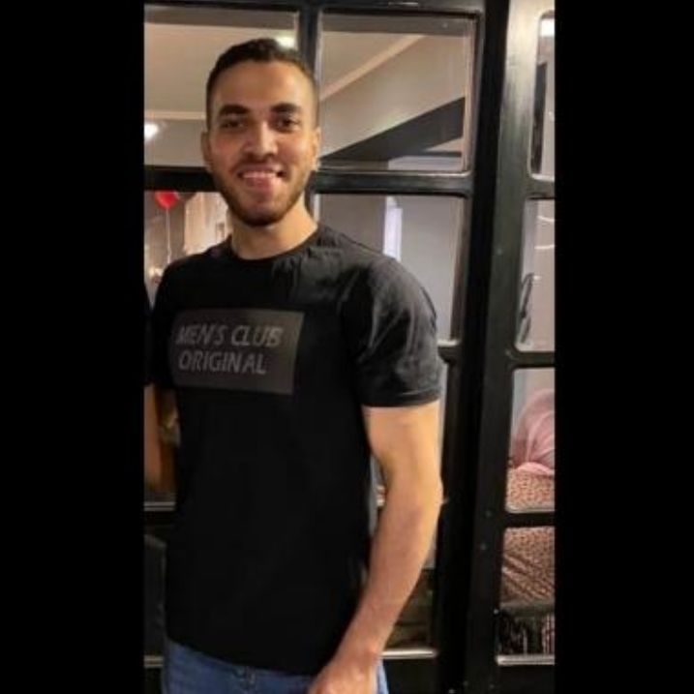
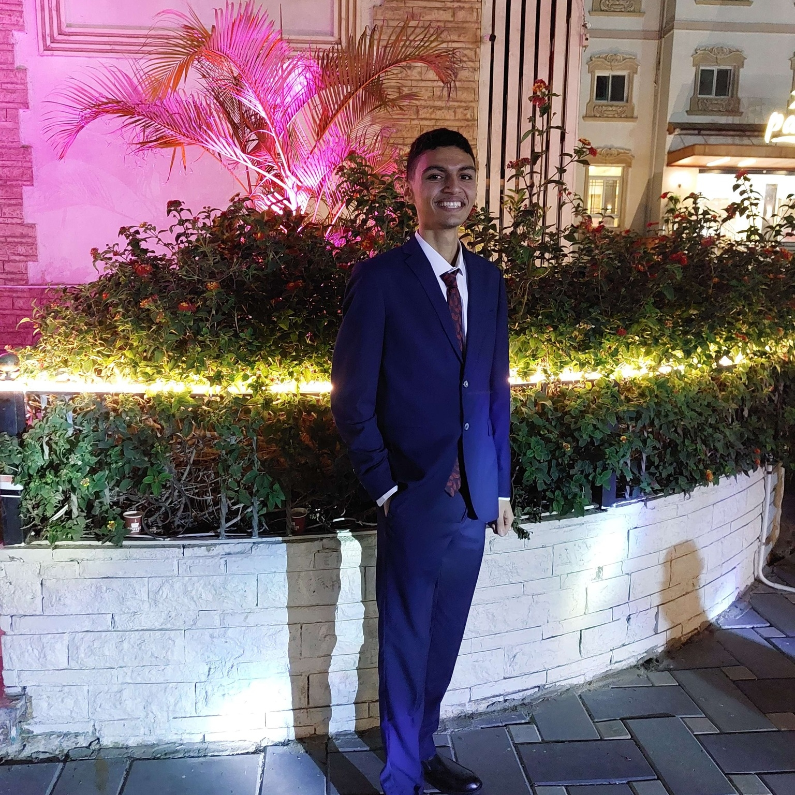

Our team
Kareem Hamdeen
Omar Ashraf
Omar Mohamed Hanafy
Omar Mohamed Abd el sater
Amr Emad
Mahmoud El sayed

Slide 3
Table of contents
01
02
03
04
05
06
Introduction
The Problem
Objectives
The Solution
Challenges
Solving challenges
07
08
09
Future Work
Tools and technology
Questions

Slide 4
01
Introduction

Slide 5
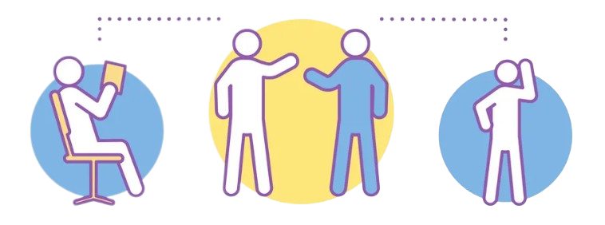
What is Body Langugae?
Body language is a powerful form of nonverbal communication that can convey emotions, intentions, and attitudes.
Body language is a universal form of communication that transcends language barriers and is often more impactful than verbal communication alone.
Body language is a crucial aspect of communication that can reveal a person's true thoughts and intentions.

Slide 6


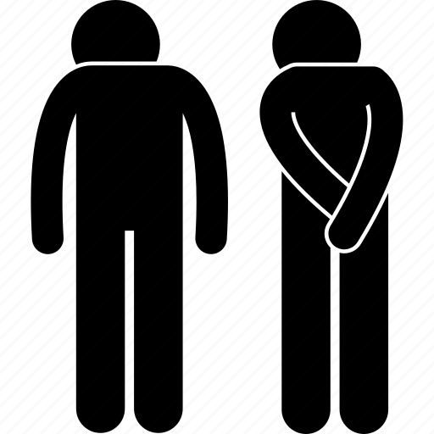
Types of Body Language?
Facial Expressions
Hand Gestures
Body Movements

Slide 7
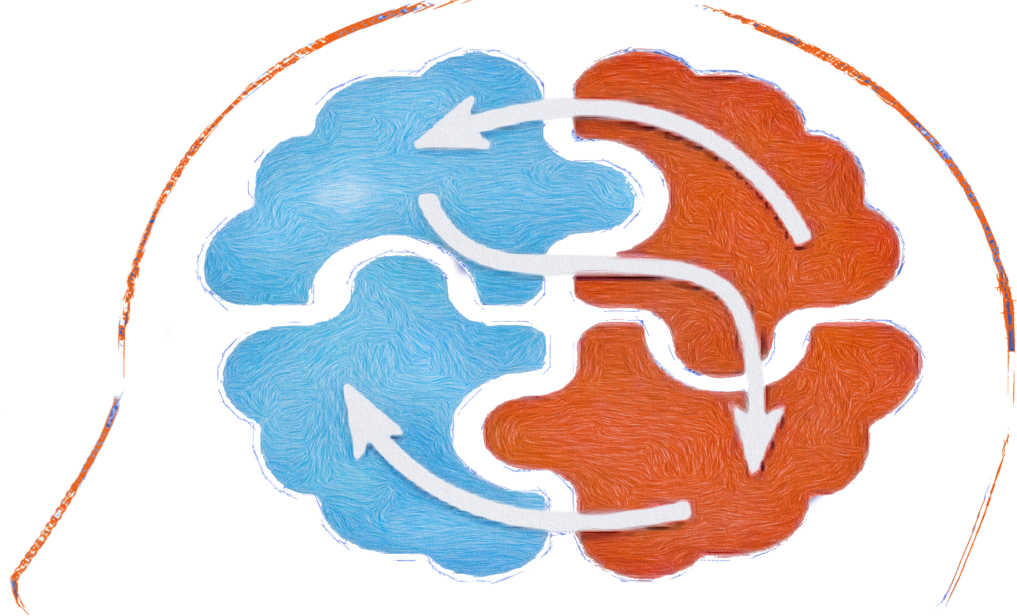
Overview of the project
Our project is a website which aims to leverage artificial intelligence to analyze and decode body language from videos.

Slide 8
02
The Problem

Slide 9
The Problem
1) Misunderstanding nonverbal cues
2) Inconsistency between words and body language
4)Body language in conflicts
3)Unconscious signals

Slide 10
03
Objectives

Slide 11
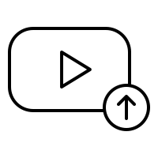


Objectives
Chatbot
Upload video
Statistics
Help user to know about our project and if the user have a problem chatbot will help him
User upload video so the ai algorithm can analysis it to decode the body language
Users can access statistics for each uploaded video to see statistics about the decoded body language

Slide 12
04
Solution

Slide 13

How did we get the actions?
"Body Language Decoder" leverages insights from the renowned book "What Every Body is Saying" by Joe Navarro to identify and interpret various actions and their corresponding meanings.

Slide 14
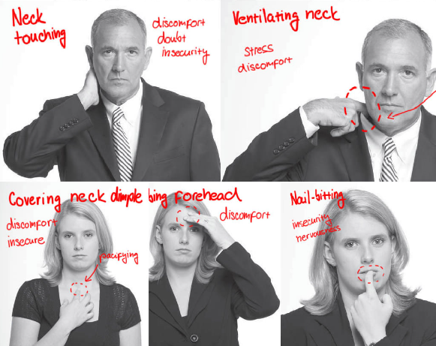
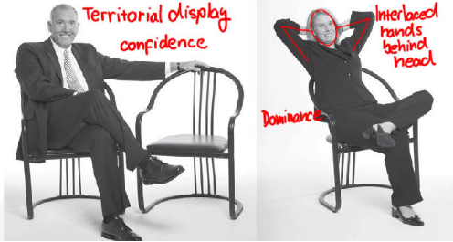
Examples

Slide 15
The Solution
"Body Language Decoder" is an AI website that analyzes and interprets human body language. Upload a video, and our advanced algorithms accurately detect and decode body language, revealing the true meanings and intentions behind actions. Enhance your understanding of non-verbal communication with our state-of-the-art technology.
It will be picture of landing page

Slide 16


User Scenario

Slide 17


Admin Scenario

Slide 18
Demo Video
Will be demo video about the project

Slide 19
05
Challenges

Slide 20



Challenges
Dataset
AI Technologies
Body Landmarks

Slide 21
06
Solving challenges

Slide 22
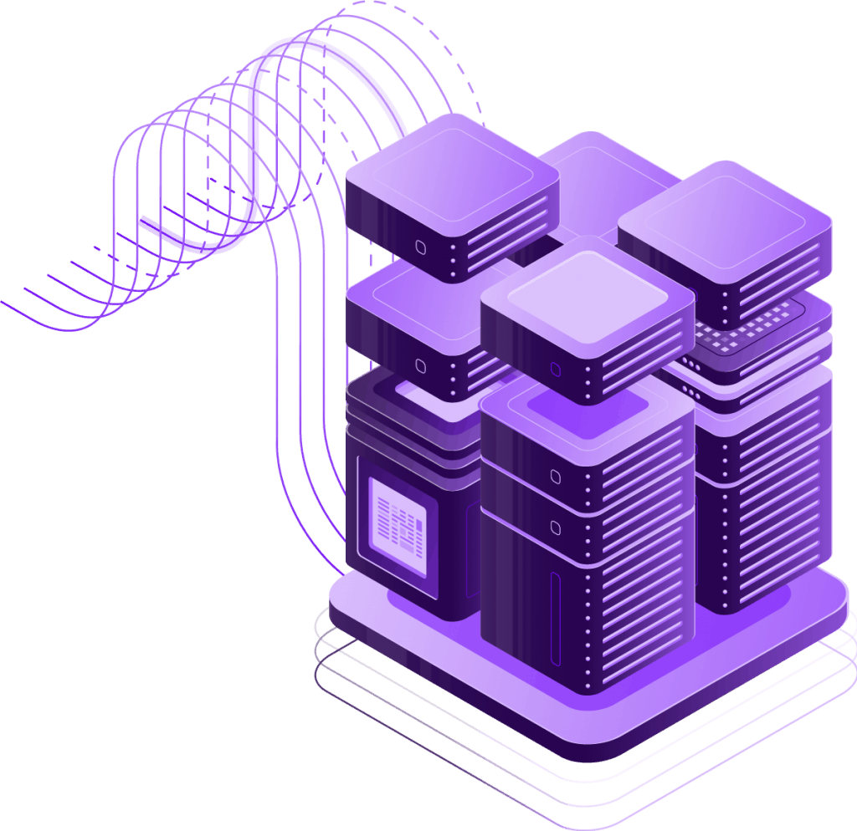
Dataset Collector
We have established a dedicated website with the purpose of acquiring additional datasets to augment our AI project and further enhance its capabilities.

Slide 23
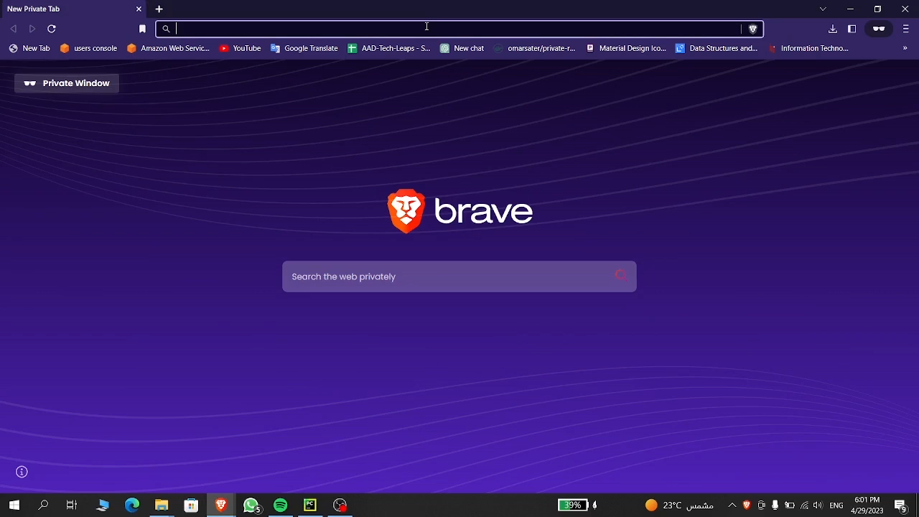
Demo Video

Slide 24
AI Technologies
Classification
Neural Networks
Logistic Regression (Accepted)
Decision Tree
Naïve Bayes
Gradient Boosting
Ridge
KNN
Random Forest
LSTM
CNN

Slide 25
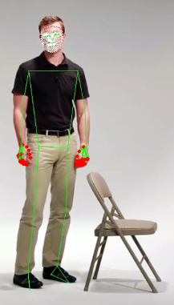
Body Landmarks
The presence of 468 facial landmarks and 75 combined landmarks for pose and hands can mutually influence each other. Even if the model doesn't rely on facial information, the facial landmarks can still impact the accuracy of the action predictions.

Slide 26
07
Future Work

Slide 27
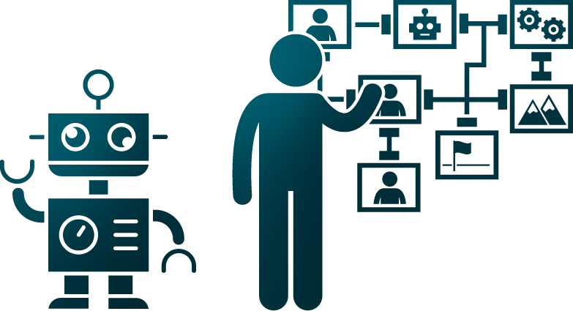
Future Work
Increase the data collected from Volunteers
Making an application version for android and IOS mobile phones to make it easier for the users to interact with our project.
Making the website supports different languages to gain more audience from all over the world.
Ensure that the user private data are fully protected and secured.

Slide 28
Future Work
Using a more powerful server so the website can handle more users and requests without crashing the website.
Enhance ai model so it can detect more actions and be able do identify action with high similarities and increase the model accuracy .
Increase the system features so it can be commercially used by companies and users by using the trending technologies.

Slide 29
08
Tools And Technologies

Slide 30




Tools And Technologies

Slide 31


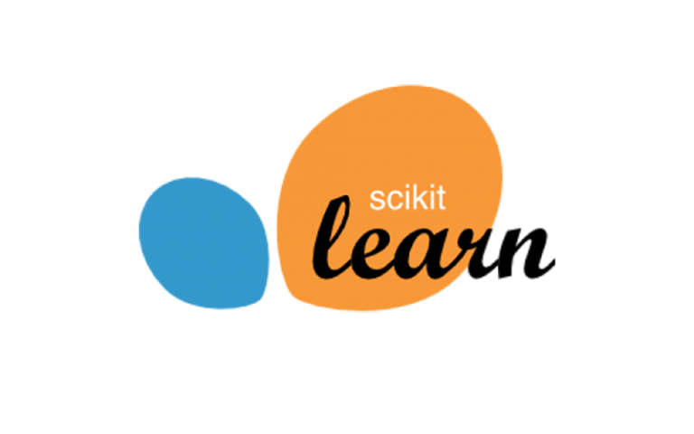

Tools And Technologies

Slide 32
08
Questions?

Slide 33
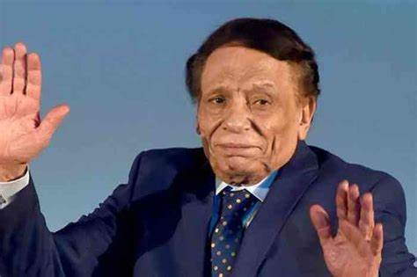
Thanks.

